Slide 1

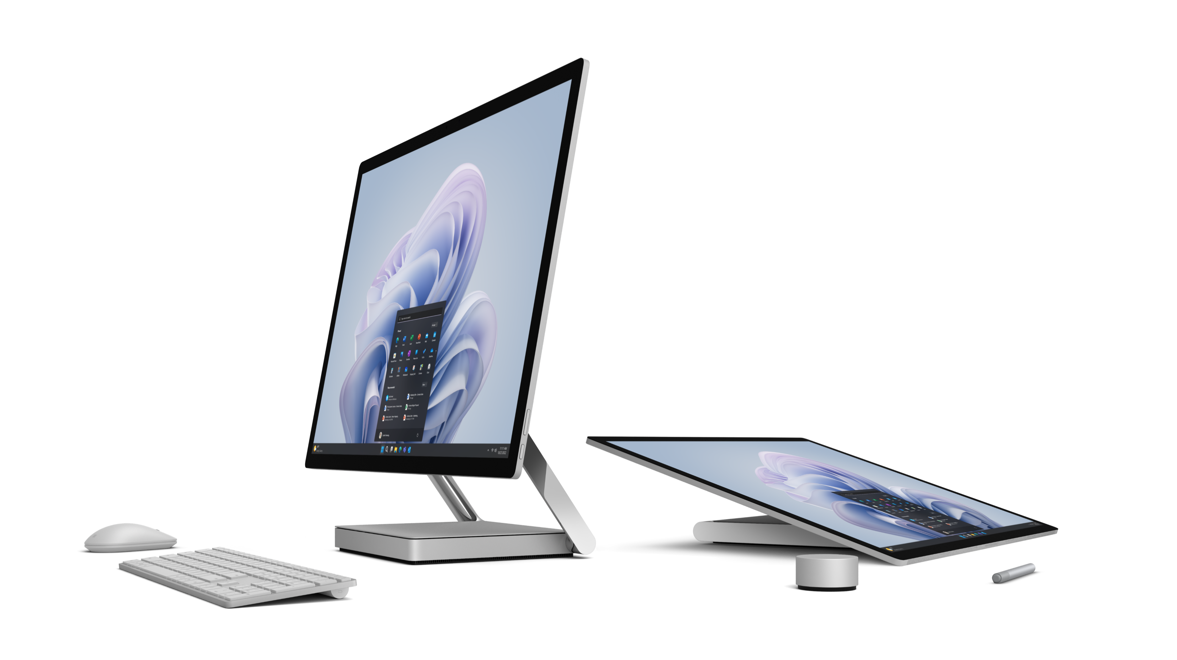




Partner Logo = *[$profile.logo;size<40.64x6.35>; type:<dark>;align:<left>;bc:#FFFFFF]*
Achieve cyber resilience with Microsoft Surface and Microsoft 365
Designed by Microsoft, a security and device combination that doesn’t sacrifice innovation or productivity.
Collaboration anywhere has increased business risk.
Organizations are shifting focus to prevention and being resilient in the wake of an inevitable attack. Cyber resilience begins with choosing technology designed to eliminate vulnerabilities present in hardware and operating systems and extending the choice to cloud environments.
5x
45%
30%
Increase in cyberattacks against remotely managed devices between May 2021 and May 2022.¹
of security professionals identify email and collaboration tools as the aspect of their organization most susceptible to attacks.2
reduced employee time lost
to security incidents.3
Notes:
*Software license required for some features. Sold separately.
¹Microsoft, Microsoft Digital Defense Report 2022, 2022.
²Microsoft, Cyber Resilience, 2022.
³A Business Value White Paper, commissioned by Microsoft September 2022 | Doc. #US49453722 IDC Research Study conducted from surveys and interviews between December 2021–February 2022. All respondents were IT decision-makers at large organizations (250-5000+ employees) representing organizations from the United States, Australia, India, Spain, France, United Kingdom, New Zealand, and Germany. Cost & Savings findings based on average cost and time estimates provided directly by respondents; actual costs and savings may vary based on your specific device mix and deployment. For the detailed study, click here.​​

Slide 2




Partner Logo = *[$profile.logo;size<40.64x6.35>; type:<dark>;align:<left>;bc:#FFFFFF]*
Eliminate passwords
Streamlined, secure, remote management
Secure collaboration across apps and cloud environments
At startup, password-less, secure sign-in with Windows Hello for Business offers the highest level of biometric security with infrared camera sensors to enhance facial recognition. Biometric sign-in is the most difficult to replicate, ensuring only authorized users can access the device.
Managing device security remotely saves time, reduces the possibility of firmware or ransomware attacks, and can remediate problems before they get too far. Microsoft Intune* handles mobile device management and has a built-in portal to self-serve, manage, and monitor Surface devices (Surface Management Portal).
Achieve organizational resilience with a Zero Trust approach to security and risk management. Windows Autopilot allows remote setup and configuration of devices with the proper security settings and policies.
Feel confident you’re resilient against attacks
Microsoft Surface can help solve the security gap by empowering security teams, line-of-business leaders, and workers. Designed to be secure, Surface devices combined with Windows 11 and Microsoft 365* deliver an integrated solution, with built-in layers of protection and remote device management that extend from hardware and firmware to the cloud.
Want to learn more about building your cyber resilience with Microsoft Surface?
Get in touch with your representative today.
* Software license required for some features. Sold separately.
¹ Microsoft, Microsoft Digital Defense Report 2022, 2022.
² Microsoft, Cyber Resilience, 2022.
³ A Business Value White Paper, commissioned by Microsoft September 2022 | Doc. #US49453722 IDC Research Study conducted from surveys and interviews between December 2021–February 2022. All respondents were IT decision-makers at large organizations (250-5000+ employees) representing organizations from the United States, Australia, India, Spain, France, United Kingdom, New Zealand, and Germany. Cost & Savings findings based on average cost and time estimates provided directly by respondents; actual costs and savings may vary based on your specific device mix and deployment. For the detailed study, click here.​​
Notes:
*Software license required for some features. Sold separately.
¹Microsoft, Microsoft Digital Defense Report 2022, 2022.
²Microsoft, Cyber Resilience, 2022.
³A Business Value White Paper, commissioned by Microsoft September 2022 | Doc. #US49453722 IDC Research Study conducted from surveys and interviews between December 2021–February 2022. All respondents were IT decision-makers at large organizations (250-5000+ employees) representing organizations from the United States, Australia, India, Spain, France, United Kingdom, New Zealand, and Germany. Cost & Savings findings based on average cost and time estimates provided directly by respondents; actual costs and savings may vary based on your specific device mix and deployment. For the detailed study, click here.​​

