Slide 1
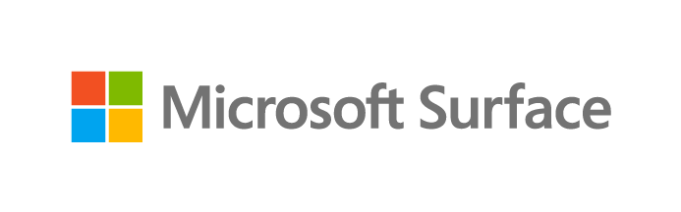

Driving success through employee experience: The role of device choice in modern work

Slide 2

Welcome to the era of modern work, where flexibility, empowerment, and resilience drive success.
This e-book explores the relationship between modern work, employee empowerment, and technology's role in driving connection, collaboration, and innovation.
You’ll learn how device choice plays a key role in modernizing the employee experience and opening new possibilities for your organization.
Modern work is a mindset
Modern work fosters innovation, collaboration, and continuous learning, and empowers employees to produce impactful work with less stress. Building an employee-centric work environment takes flexibility, adaptability, and effective use of technology.
That includes device choices that unlock diverse modes of working, enable employees to learn and embrace new technology, expand group interactions through modern tools, and seamlessly interact with software to enhance job performance.
By recognizing the transformative potential of technology, organizations empower IT decision-makers (ITDMs) and CIOs to drive business success. These stakeholders have a growing responsibility to shape technology adoption, nurture innovation, improve productivity, and architect experiences aligned with modern work.
Future-focused IT strategies prioritize employees by leveraging user research, data, and experiences to ensure satisfaction, and enable agile responses to changing circumstances. They ensure organizations can navigate uncertainty effectively, ultimately fueling resilience.
PAGE 2

Slide 3
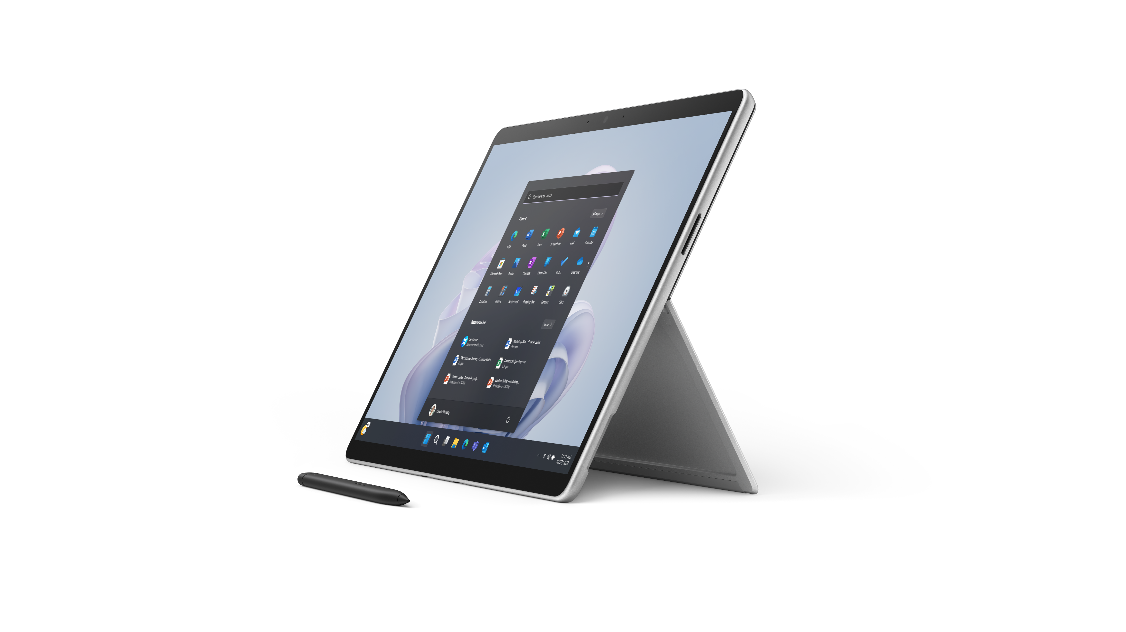

The employee experience builds business resilience
Positive employee experiences elevate satisfaction, drive performance, and deliver business success. Investing in a positive work environment leads to higher retention, lower absenteeism, and reduced turnover. Engaged employees are more effective, perform better, and produce higher-quality work.
Together, these benefits build business resilience and agility, enabling organizations to navigate unforeseen events and market changes, sustain operations, and recover quickly. When businesses are agile and resilient, they have a foundation for sustained growth and long-term success.
The outcomes of resilience
Business resilience is about seizing opportunities in turbulent times, not just survival. These are the outcomes organizations can expect from building resilience:
01
Ability to navigate unforeseen events and market changes
Resilient companies empower their workforces to be agile, adaptable, and proactive, driving progress even in an environment of radical change.
02
Sustained operations
Advanced tools, systems, and infrastructure empower employees to improve organizational efficiency, accelerate speed to market, reduce costs, and streamline product delivery.
03
Swift recovery from disruptions
Replacing legacy systems and technology drives business continuity and better disaster recovery by optimizing resource use, accelerating response time, and supporting and safeguarding flexible work arrangements.
PAGE 3

Slide 4


What do employees want?
01
Work that centers on collaboration
Uninterrupted time with minimal disruptions for meetings and tasks
Adaptive technology for collaboration, creativity, productivity, and mobility
Video conferencing tools that provide equitable participation from anywhere
02
Opportunities to learn, grow, and contribute
Continuous access to skill-building and growth
Opportunities for accelerated learning
Technology that stimulates curiosity and supports continual growth
03
Technology that unlocks potential
Versatile, easily managed hardware that reduces the need for multiple devices
Intuitive technology that shortens the learning curve and enables imaginative problem-solving
Maximizing talent and performance through streamlined technology
Employees
expect more
Modern work prioritizes well-being in a positive environment. It delivers flexibility and autonomy so employees can choose the work arrangements that help them function at their best. By centering the workplace on human needs and experiences, modern workplaces improve productivity and efficiency.
As work evolves, employees expect improved connections, personalized career development, skill expansion, and up-to-date devices. Meeting these expectations boosts engagement, growth, and employee satisfaction.
PAGE 4

Slide 5
Technology is at the heart of the employee experience
What is digital debt? Digital debt is the burden of unfinished
tasks and unprocessed information that accumulates in the digital work environment. It’s a result of the overwhelming volume of emails, meetings, chats, and notifications
that lead to increased stress and anxiety. Managing digital debt requires effective strategies and tools to prioritize tasks and streamline workflows, promoting
productivity and work-life balance.
Technology plays a crucial role in shaping the modern employee experience. From advanced productivity apps and collaboration tools to versatile devices, technology simplifies processes and workflows. Smooth connections and communication tools ensure seamless and secured access to resources and opportunities, promoting equitable access for all employees—regardless of their location.
Modern devices reduce employees’ stress by streamlining tasks, alleviating workloads, and enhancing their natural capabilities. That improves work quality, individual performance, and overall business outcomes. As AI-powered tools continue to emerge, they lighten workloads and reduce digital debt.
AI is shifting the focus of work from processes and policies to people. Moving forward, it will be a key instrument for reducing digital debt and building better experiences. As virtual co-pilots get more complex and capable, they’ll set employees free to pursue the human side of work: creativity, relationships, and solving organizational problems.
Extending employee capabilities: By collaborating on complex tasks like data analysis, creative work, copywriting, editing, and idea generation, AI saves time, enhances creativity, and minimizes workflow obstacles.
Streamlining work processes: Automation diminishes the tedium of manual work, including remote management of devices for IT teams. By automating routine tasks, employees can focus on more strategic and value-added activities.
Boosting productivity through collaboration: Tools like Surface Hub 2S for Business powered by AI, interactive touchscreens, and on-screen inking enable interactive teamwork, efficient note-taking, and natural creative expression. They drive enhanced productivity and organizational success.
64%
of people say they struggle with having the time and energy to do their job—and those people are 3.5x more likely to also struggle with innovation and strategic thinking.¹
68%
of people say they don’t have enough uninterrupted focus time during the workday.¹
62%
say they struggle with too much time spent searching for information in their workday.¹
¹Microsoft, Work Trends Index Annual Report: Will AI Fix Work?, May 2023.
PAGE 5
Notes:
¹Microsoft, Work Trends Index Annual Report: Will AI Fix Work?, May 2023.

Slide 6

Why device choice matters
Device choice is one of the primary factors ITDMs can influence to enhance performance and productivity. Selecting the right device empowers employees to do their best work, regardless of their location.
Surface is the best expression of Microsoft
The modern workplace relies on modern devices, and we designed Surface devices to deliver the best of Microsoft. They combine premium hardware, Windows 11, Microsoft 365,* and AI-powered tools on select devices to improve results and elevate collaboration.
Elevating ability
Choosing devices that offer innovative ways to work give employees the freedom to explore new methods and technologies, coordinate their efforts, and accomplish more. Surface adapts to the diverse ways people work as their tasks continue to evolve.
Unlocking potential
Day-to-day experiences unlock future growth. Technology powers that potential, and Surface devices match the needs of emerging work modes and new kinds of employees. With AI assistance, workers can maximize their impact. At the same time, versatile form factors like 2-in-1 laptops empower people to work in the mode that fits the task at hand without breaking their flow. On-screen inking unlocks creative ideation, while adaptive accessories and all-day battery life¹ mean your team’s efforts go uninterrupted.
Leveraging an ecosystem
Surface provides the best expression of the Microsoft ecosystem, powered by Windows 11 and Microsoft 365.* Cloud-first experiences enable teams to work easily from anywhere. Highly mobile form factors and reliable connectivity meet the demands of modern work, providing access to tools that make communication, information sharing, and real-time interaction smoother while improving work output in any setting. With Surface, technology fades into the background as premium video and audio capabilities, seamless connectivity, and collaborative tools like Microsoft Whiteboard take center stage.
Building cyber resilience
Surface delivers world-class security to safeguard employees and enable quick recovery from incidents. Proactive defensive measures continuously evolve to counter rapidly advancing global threats. Chip-to-cloud security provides comprehensive protection for both people and data.
Surface ensures security at every layer, including the firmware and Microsoft-maintained UEFI,² as well as the operating system and cloud environment. Meanwhile, Microsoft Intune* admin center and Windows Autopilot streamline device management and security to help minimize disruptions.
*Software license required for some features. Sold separately.
¹Battery life varies significantly based on usage, network and feature configuration, signal strength, settings and other factors. See aka.ms/SurfaceBatteryPerformance for details.
²Surface Go and Surface Go 2 use a third-party UEFI and do not support DFCI. DFCI is currently available for Surface Pro 7+, Surface Laptop Go, Surface Book 3, Surface Laptop 3 and Surface Pro X. Find out more about managing Surface UEFI settings and Surface devices on which DFCI is enabled.
PAGE 6
Notes:
*Software license required for some features. Sold separately.
¹Battery life varies significantly based on usage, network and feature configuration, signal strength, settings and other factors. See aka.ms/SurfaceBatteryPerformance for details.
²Surface Go and Surface Go 2 use a third-party UEFI and do not support DFCI. DFCI is currently available for Surface Pro 7+, Surface Laptop Go, Surface Book 3, Surface Laptop 3 and Surface Pro X. Find out more about managing Surface UEFI settings and Surface devices on which DFCI is enabled.

Slide 7
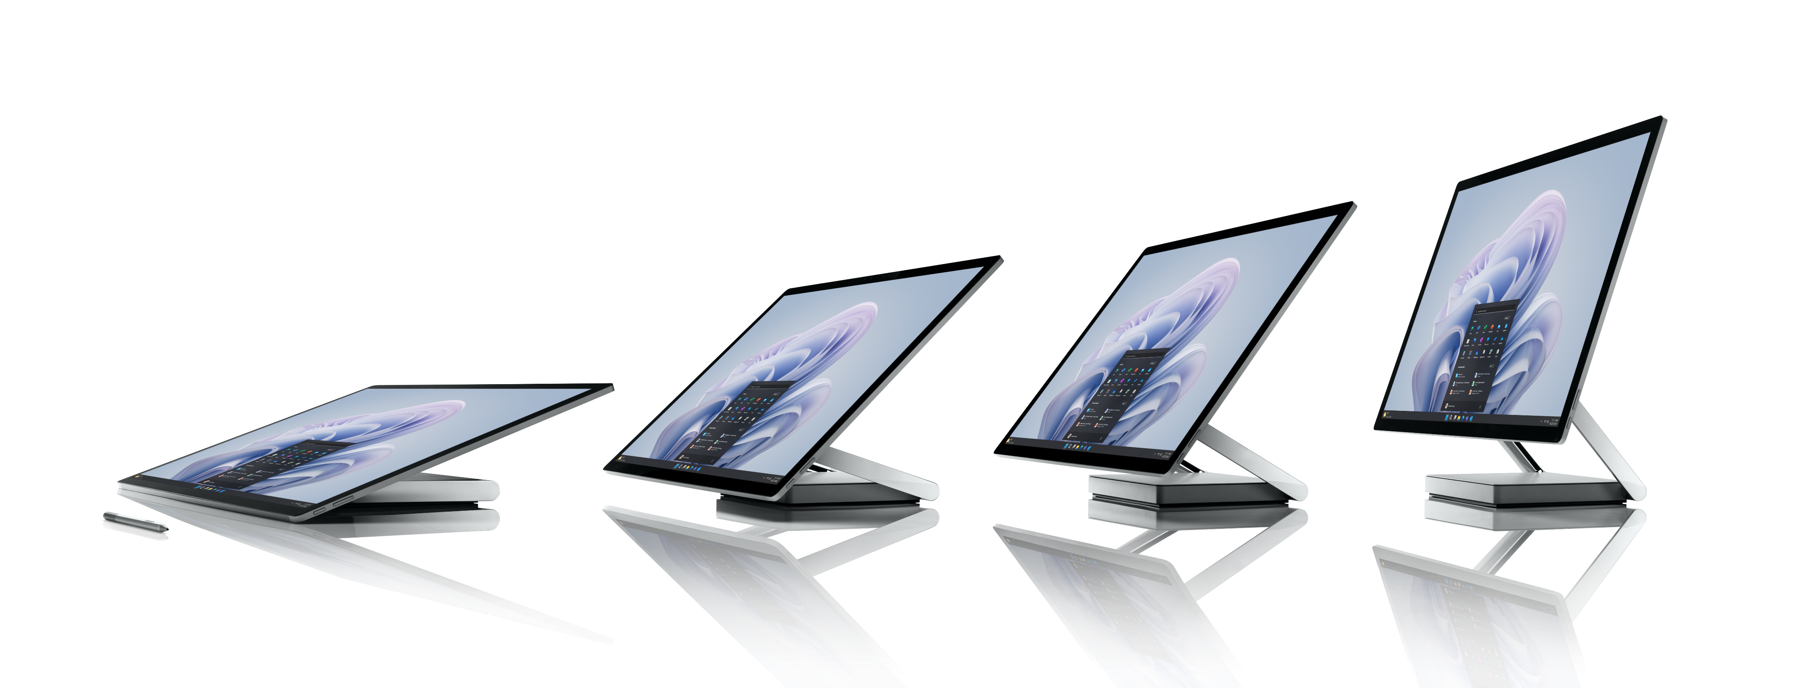
Embracing a human-centric approach with Surface
We designed Surface devices to provide better work experiences by seamlessly combining hardware and software, enabling powerful productivity and effortless teamwork between employees, regardless of their roles or locations. With Surface, employees can quickly adapt to different work scenarios, augment their skills, and unlock their organization’s full potential.
The combination of Surface hardware and familiar software tools paired with streamlined device management ensures exceptional, disruption-free experiences.
Microsoft Surface also prioritizes proactive protection and security, keeping organizations and employees safe from escalating threats. When people feel happy, secure, and confident in the tools they use to do their jobs, they can stay focused under any conditions.
Unlocking the potential of a resilient and innovative workforce
As modern work evolves, organizations are prioritizing employee-centric experiences to harness the full potential of their workforce. By providing employees with the right technology, businesses create a work environment that motivates them to be proactive, inventive, agile, adaptable, and resourceful.
Modern work experiences fuel business resilience. They enable organizations to navigate disruptions, outpace competitors, and embrace future innovations.
With an empowered workforce supported by modern devices, companies establish a solid foundation for growth in a continually evolving business landscape.
By championing employee empowerment and leveraging the transformative power of technology, businesses can confidently navigate the challenges of modern work. They pave the way for a better future where resilience and innovation are integral to company culture.
It's time to embrace the power of the modern workforce and embark on a journey of growth, resilience, and unlimited possibilities.
Extending IT efficiency with
Microsoft Surface
44%
organizations consolidated 2.3 devices on average.¹
49%
fewer helpdesk incidents.¹
40%
reduced IT staff time spent on maintenance.¹
¹A Business Value White Paper, commissioned by Microsoft September 2022 | Doc. #US49453722 - IDC Research Study conducted from surveys and interviews between December 2021 – February 2022. All respondents were IT decision-makers at large organizations (250-5000+ employees) representing organizations from the United States, Australia, India, Spain, France, United Kingdom, New Zealand, and Germany. Cost & Savings findings based on average cost and time estimates provided directly by respondents; actual costs and savings may vary based on your specific device mix and deployment. For the detailed study, click here.
PAGE 7
Notes:
¹A Business Value White Paper, commissioned by Microsoft September 2022 | Doc. #US49453722 - IDC Research Study conducted from surveys and interviews between December 2021 – February 2022. All respondents were IT decision-makers at large organizations (250-5000+ employees) representing organizations from the United States, Australia, India, Spain, France, United Kingdom, New Zealand, and Germany. Cost & Savings findings based on average cost and time estimates provided directly by respondents; actual costs and savings may vary based on your specific device mix and deployment. For the detailed study, click here.

Slide 8

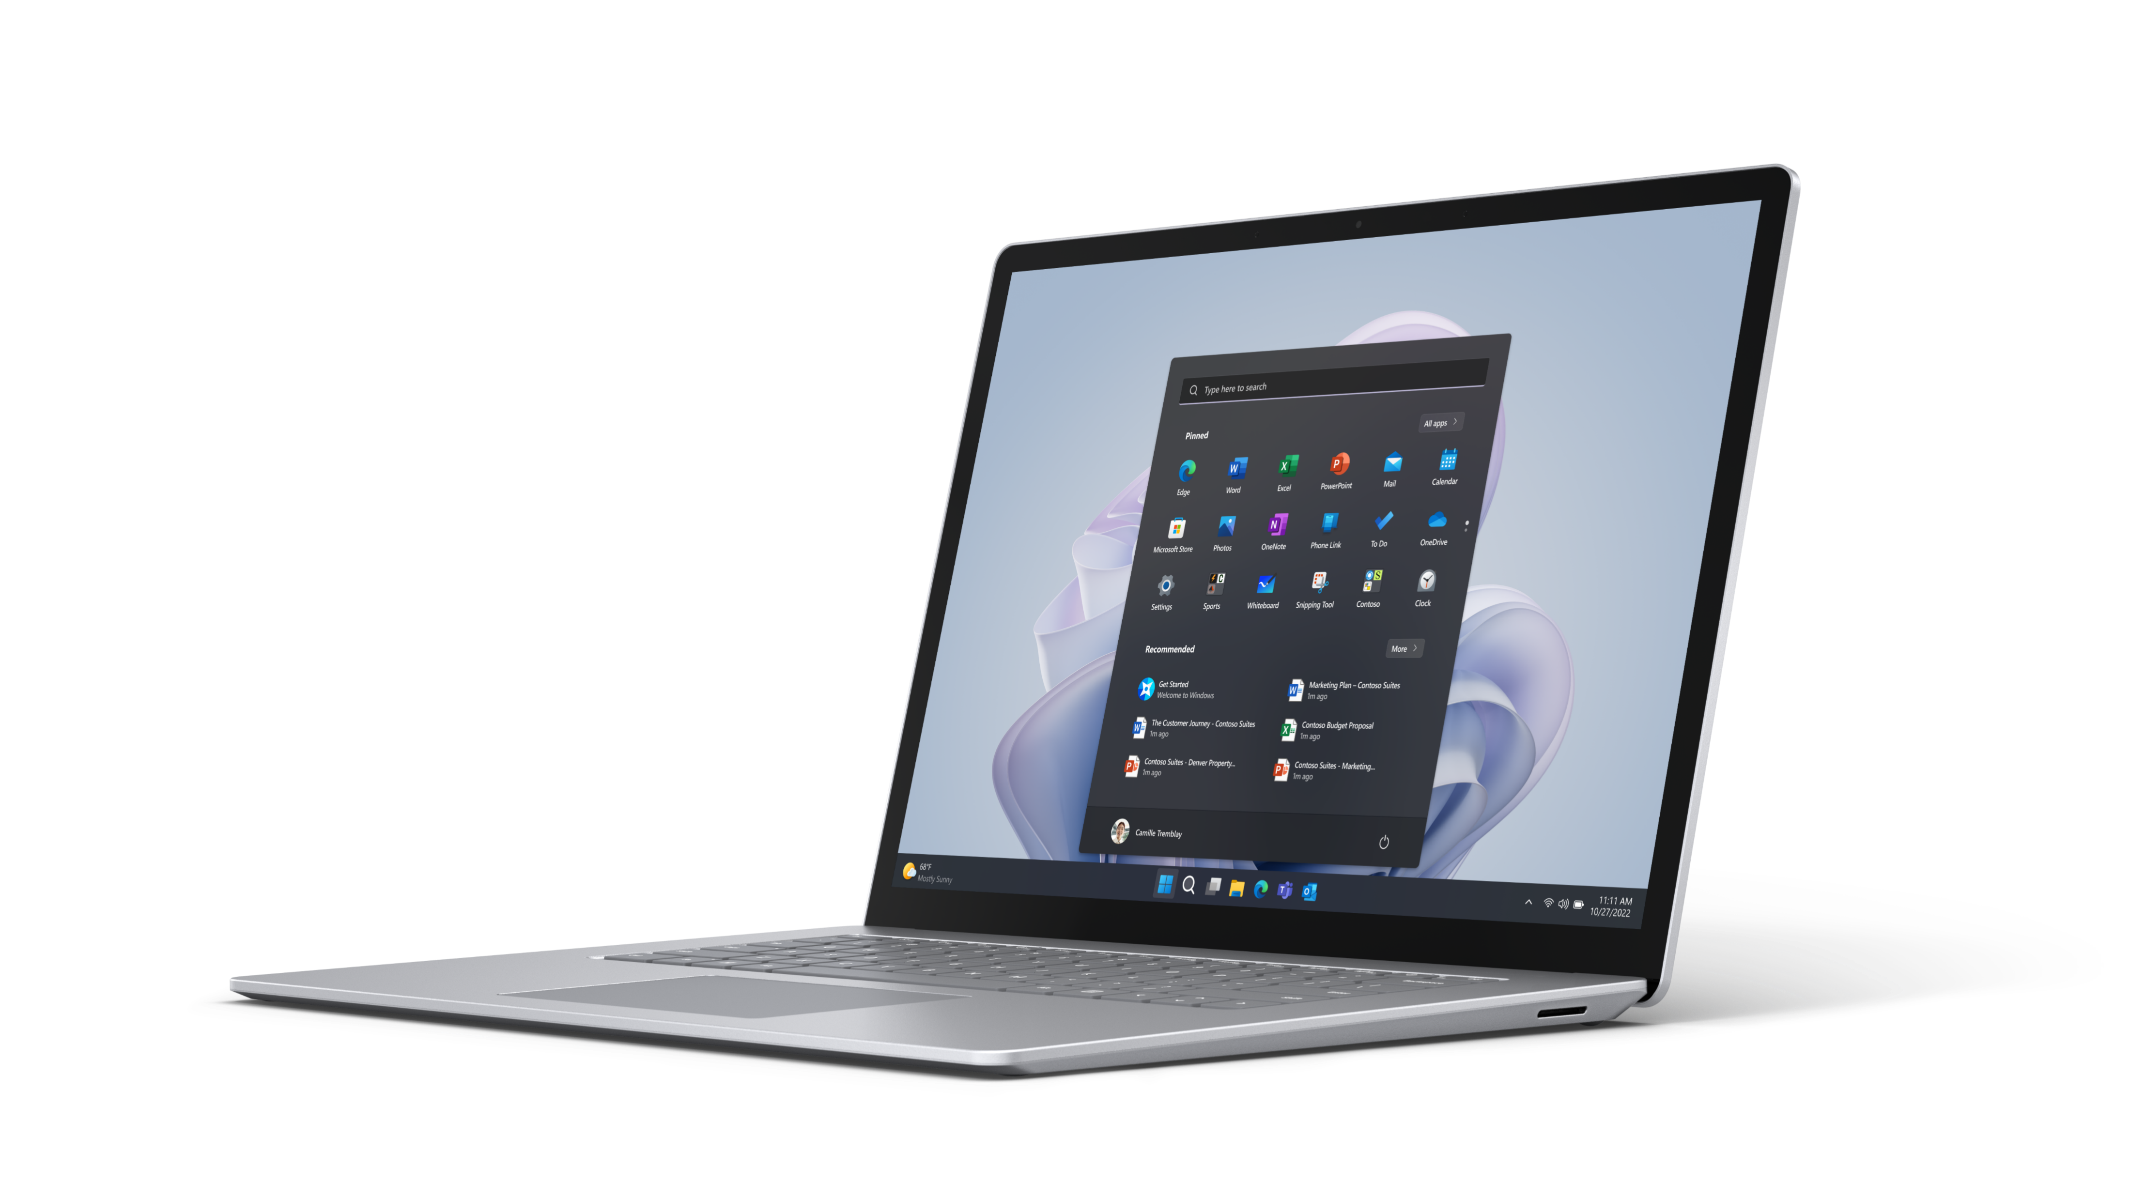
Preparing for the modern workplace
Every company needs to meet current technology requirements while preparing for future trends. Planning to build flexible and adaptable technology infrastructure boosts business resilience. It delivers agility, performance, reliability, and great experiences while simplifying IT.
Tactical innovations like 2-in-1 form factors, touch screens, and collaboration through Microsoft Teams enhance productivity. Looking forward, CIOs have an opportunity to track progress around virtual and augmented reality, AI, and automation to develop new methodologies and remain competitive. It takes a strategic mindset for IT leaders to adopt new technology and select scalable services. Making that approach people focused and leveraging employee knowledge promotes resilience, flexibility, and better employee experiences.
Input from all kinds of employees—from IT teams to the front line—can help you identify your technology needs. By recognizing the gaps in capabilities and addressing them, you empower your workforce, replace outdated technology, streamline complex processes, and improve security. A technology-enabled and employee-centered approach lays the foundation for a modern workplace that drives long-term success.
60%
of people say they don’t currently have the right capabilities to get their work done.¹
¹Microsoft, Work Trends Index Annual Report: Will AI Fix Work?, May 2023.
PAGE 8
Notes:
¹Microsoft, Work Trends Index Annual Report: Will AI Fix Work?, May 2023.

Slide 9

Tips for bringing modern work and technology to your organization
Overcoming challenges in technology adoption to build resilience
01
Keep employees informed and engaged by involving them in
the technology selection process.
A strategic approach to deploying and adopting new technologies helps you overcome challenges.
Consider these key strategies:
02
Clearly communicate why you’re implementing new workplace technology and how it will
benefit employees.
03
Use technology to enhance the employee experience by providing tools and solutions that
streamline their work and make tasks more efficient.
01
Assess current processes and identify areas where new technology will add value. Establish a strong vision and align it with your business goals to guide the adoption process.
04
Break your workforce into segments based on their needs and provide targeted support for each group.
02
Provide proper training to employees and address any resistance to change. Implement change management initiatives to ensure smooth adoption and effective cases for new technologies.
05
Offer comprehensive training programs and allocate time for employees to learn and familiarize themselves with new technology.
03
Encourage a mindset of innovation and experimentation within the organization. Embrace a culture that promotes learning, enabling quick adaptation to new technologies and continuous improvement.
By implementing these strategies, you can overcome challenges, unlock the potential of new technology, and drive growth and competitiveness within your industry.
PAGE 9

Slide 10

Choosing the right partner for your modern work strategy
Selecting the right IT partner maximizes your team’s day-to-day capabilities and prepares them for future technological advancements. A trusted partner helps you assess your device requirements, evaluate your options, ensure compatibility, address security concerns, and provide ongoing device management and support.
By partnering with an IT provider, you can streamline your technology solutions and reduce the need to manage multiple vendors.
The right partner can recommend hardware, software, and security solutions tailored to your specific business needs. They have the knowledge and experience to assist you in designing and implementing employee empowerment and business resilience plans that align with your goals and set your teams up to perform at their best.
PAGE 10

Slide 11

A checklist for meeting your technology needs now, and in the future
To build a strong foundation for the future of work, understand where your device portfolio stands and ensure alignment with your company's vision. Ask yourself these questions:
Key considerations for developing your technology strategy
Guide conversations and maximize your company's potential today while preparing for future innovation. Reflect on the following questions:
What priority do we place on creating meaningful employee experiences?
Are we positioned to have the necessary skills and talent to succeed in the future?
Do we have a deep understanding of modern employees’ diverse and changing needs?
Are we equipped with the tools to anticipate and adapt to changing employee needs and evolving work styles?
Are we willing to invest in device upgrades to empower employees and support their growth?
How will our technology choices impact the security and resilience of our organization?
Assessing technology needs for today
Evaluate your systems, processes, and infrastructure for improvement and optimization. Consider these questions:
What are the pain points and inefficiencies in our technology setup?
Does our current workplace technology effectively alleviate employee workloads, enhance their abilities, and foster productivity, communication, and collaboration?
How much training do employees require to familiarize themselves with new technology?
Are our systems, infrastructure, and devices scalable enough to support future growth?
Do we have the necessary security measures in place to safeguard our data?
Are there any compliance or regulatory requirements we need to consider?
PAGE 11

Slide 12

Incorporating emerging technologies into future growth
In addition to addressing current technology requirements, businesses should proactively incorporate emerging technologies to drive future growth. These efforts involve staying informed about the latest advancements and trends with the potential to transform industry and business processes. Consider the following questions to leverage emerging technology effectively:
How well does your organization understand emerging technology and the skills required for success?
What systems or channels are in place to stay keep you informed about relevant emerging technologies?
Can your organization identify and conduct pilot projects and proofs of concept to evaluate the feasibility and benefits of implementing emerging technologies?
Does your organization have trusted partners who specialize in emerging technologies to collaborate with you, deliver insights, provide resources, and accelerate adoption?
Does your organization have a roadmap that outlines how emerging technologies align with your business goals and how you can work them into existing systems and processes?
Additional resources
Maximizing your ROI from Microsoft 365 Enterprise with Microsoft Surface
The Total Economic Impact of Windows 11 Pro Devices
Modernize With Surface Solutions Page
7 Trends Shaping the Future of Work and How to Prepare for the Workplace of Tomorrow Blog post
Manage Surface across the device lifecycle
Ignite 2022 | Demystifying AI, NPU, and Machine Learning within Microsoft Surface
PAGE 12

Slide 13
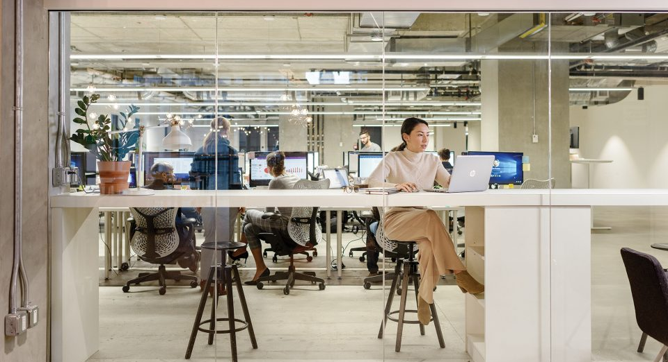

Additional resources
Dive deeper into specific Surface devices and Microsoft solutions that unlock your employees’ abilities and unleash your business’s unique potential.
Surface for business Modernize with Surface
https://aka.ms/Surface-for-business-Modernize-with-Surface
The Total Economic Impact of Windows 11 Pro devices https://aka.ms/The-Total-Economic-Impact-of-Windows-11-Pro-Devices
4 ways IT can support a human centered modern employee experience https://aka.ms/IT-Pro-Blog-4-ways-IT-can-support-a-human-centered-modern-employee-experience
Manage Surface across the device lifecycle https://aka.ms/Manage-Surface-across-the-device-lifecycle
Ignite 2022 | Demystifying AI, NPU, and Machine Learning within Microsoft Surface https://aka.ms/Ignite2022_Demystifying-AI-NPU-and-Machine-Learning-within-Microsoft-Surface
PAGE 13

Slide 14

Ready to empower your modern workforce?
Take the next step.

