Slide 1

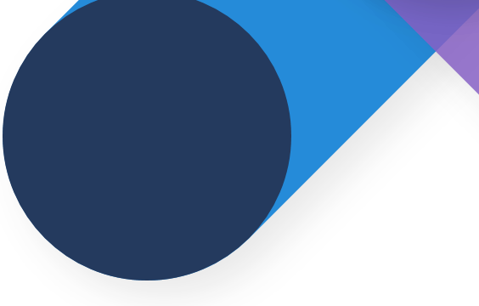
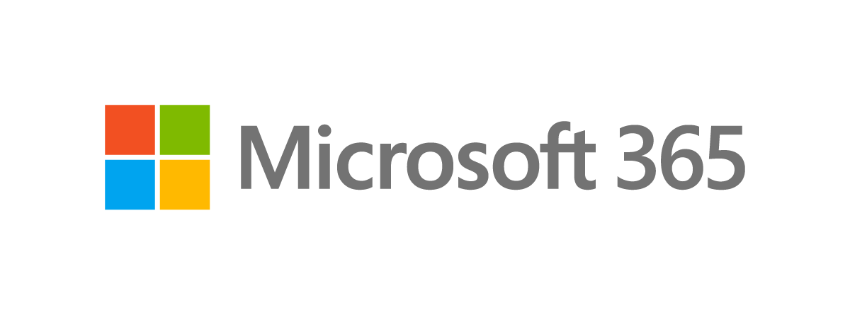
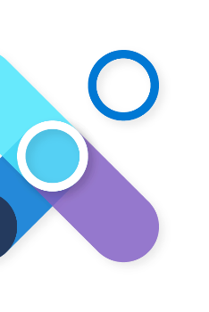


Microsoft Viva
In today's world, employees want more flexible remote work options, and meaningful in-person collaboration. Empowering people to thrive in a more flexible work world requires rethinking everything—from how you empower managers, to how you create culture, to how you reimagine the employee experience.
And that’s where Microsoft Viva comes in. As your employees are challenged with a growing imbalance between work and life, increased burnout, and decreased wellbeing, and your teams and organization face diminishing social capital, there is an urgent need to digitally reimagine the employee experience.
Discover how Microsoft Viva, an integrated platform built on top of Microsoft Teams, will help your people to be their best, to thrive in the new reality.
Microsoft Viva Workshop
Discover how Microsoft Viva helps organizations deliver personalized experiences to their employees with news, tasks, and conversations, provide data-driven insights and recommendations, organize content and expertise, and deliver formal and informal learning when and where it’s needed.
A three-phase engagement that provides an overview of the Art of the Possible, and deep dives across the Viva suite with Goals, Topics, Connections & Engage, or Learning.
Microsoft Viva Workshop
Workshop framework
Assess
Art of the Possible
Build the Plan
Gather information on key business scenarios and customer’s employee experience maturity
Define scope
Identify business stakeholders
Introduce Microsoft Viva
Microsoft Viva overview with selected pathways
Showcase employee experience transformation and dive deep into each module
Demos and immersive experiences
Prioritize customer’s top employee experience use cases and scenarios
Build a plan and define next steps to improve employee experience with Microsoft Viva
Adoption and Change Management Approach
What you can expect:
A prioritized list of business scenarios that can be addressed by deploying Microsoft Viva
Recommended preparation in terms of skills and best practices
A roadmap outlining potential workstreams and dependencies with clear next steps
An adoption framework
Contact us today to schedule your workshop!

